Slide 1

Burmese
or®musrf;pm
tkwfNrpf
Texas jrdk.rS or®musrf;pm-tkwfjrpf (edkifiHwumtrSkawmfaqmifvkyfief;)
\ wifjycsuf
www.biblebasically.org
Dr ရက္ခ္ ဂရီဖိတ္၊ စကၤပူဓမၼေကာလိပ္ • www.BibleStudyDownloads.org

Slide 2



(wnfae7mb,frSmvJ?)
taNccHusus usrf;pmav.vmNcif;
®
tydkif; 2
tpOfvdkufpDNcif;
usrf;pmyga7S;a[mif;NrdKUrsm;\aNryHk
02
©2004 TBBMI
8.0.02.

Slide 3
?
aNrxJyifv,ftwGif;wGif NzpfysufcJhaom or®musrf;pmyg taMumif;t&mrsm;
03
4

Slide 4
aNrxJyifv,f
avAekef
&I&dNynf
[dkifzm
tD&wf
*gvdvJ
tkdif
emZ&uf
e,fwef&m
awvAÁpf-*smzm
tmref
a,&k&Svif
a,&dacg
*gZm
a[NAkef
yifv,f
ao
bma&Sb
tpöa&;
a,mf'ef
tD*spf
aqmf'DDtma&As
tDvwf
t*¾byifv,f
auGU
tmP’ tm*AÁ
04
1

Slide 5
DRESSING
THE
STAGE
aNr
ed(tm)
[m
*g
cg
O
bm
J
eD
ao
tD
um
O7
aNryHkqGJedkifrnf.enf;vrf;
od
yg;
yif
Handbook pg. 15-16
05
1

Slide 6
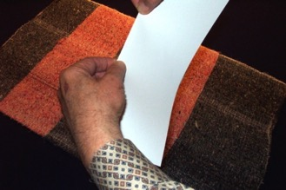
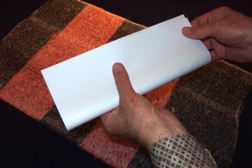
STUDY HELP #03a; (extra blank page #03b)
DRESSING
THE
STAGE
puúLNzLwckudkifxm;NyD;
tem;nDnmpGm
tvsm;vdkufacgufyg?
Handbook pg. 15-16
06

Slide 7
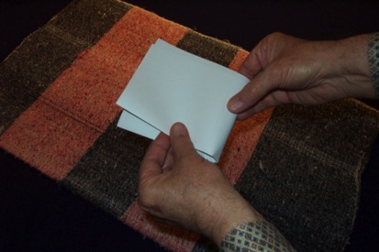
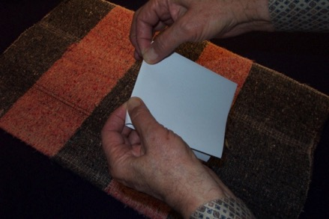
DRESSING
THE
STAGE
tem;nDpGmaemufwcg
xyfacgufyg…
…acgufpmeSpfck tem;rsm;nDnD&Sdygap
Handbook pg. 15-16
07

Slide 8
DRESSING
THE
STAGE
Handbook pg. 15-16
08
3

Slide 9
DRESSING
THE
STAGE
yxr yifv,fa&wnfae&m 6 ck
'kwd,
ukef;aNr&Sd wnfae&m 10 ck
wwd, tuGmta0;
Handbook pg. 15-16
09
2

Slide 10
DRESSING
THE
STAGE
Handbook pg. 15-16
10
1

Slide 11
DRESSING
THE
STAGE
Handbook pg. 15-16
11

Slide 12
DRESSING
THE
STAGE
a&eSif.ukef;aNr&Sd wnfae&mrsm;\trnfudk
tNynfhtpHkra&;ao;bJ
pmaMumif;\a&S.qHk;pmvHk;udkoma&;yg
Handbook pg. 15-16
12

Slide 13
DRESSING
THE
STAGE
aNr
Handbook pg. 15-16
13

Slide 14
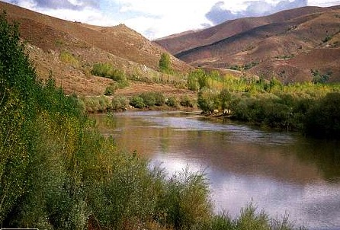
DRESSING
THE
STAGE
aNr
O
Handbook pg. 15-16
14

Slide 15

DRESSING
THE
STAGE
aNr
O
yg;
Y
Handbook pg. 15-16
15

Slide 16
DRESSING
THE
STAGE
aNr
aNrxJyifv,f
O
Oz&yfNrpf
yg;
yg;&Sm;yifv,fauGU
Handbook pg. 15-16
16
2

Slide 17
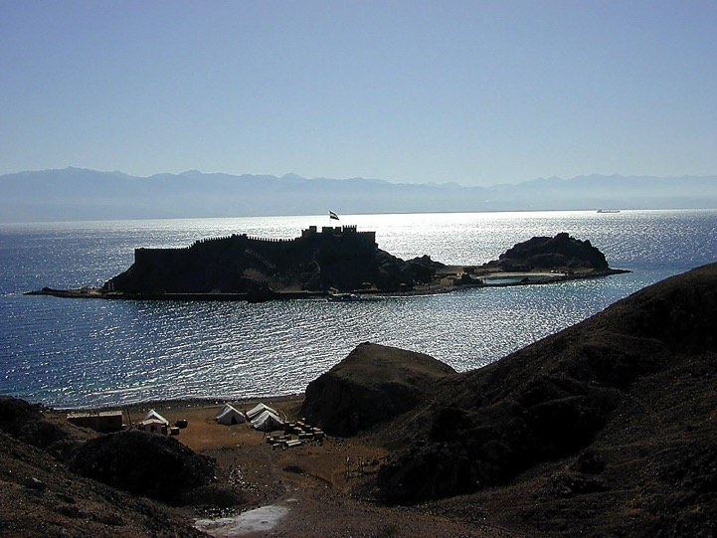
DRESSING
THE
STAGE
aNr
O
yg;
Handbook pg. 15-16
17

Slide 18
DRESSING
THE
STAGE
aNr
ER
yifv,feD
yg;
yif
Handbook pg. 15-16
18

Slide 19
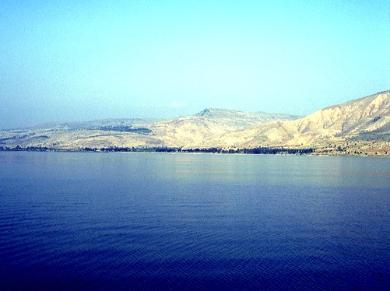
DRESSING
THE
STAGE
aNr
O
yg;
yif
Handbook pg. 15-16
19

Slide 20
DRESSING
THE
STAGE
aNr
O
yg;
yif
Handbook pg. 15-16
20

Slide 21
DRESSING
THE
STAGE
aNr
*g
*gvdvJtdkif
O
yg;
yif
Handbook pg. 15-16
21

Slide 22
DRESSING
THE
STAGE
aNr
*g
*gvdvJtdkif
O
ao
yifv,fao
yg;
yif
Handbook pg. 15-16
22

Slide 23
DRESSING
THE
STAGE
aNr
*g
O
ao
a,mf'efNrpf
yg;
yif
Handbook pg. 15-16
23

Slide 24
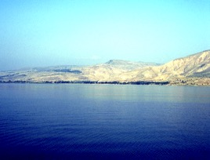

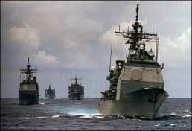
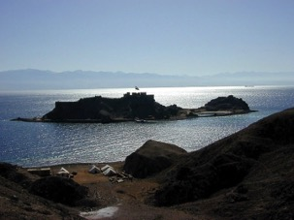
6
pmaMumif;NznfhpGufNcif;
aNr
*g
O
ao
a&wnfae&m
yg;
yif
Handbook pg. 15-16
24
7

Slide 25

pmaMumif;NznfYpGufNcif;
MS
SG
ER
“THE LAND”
DS
PG
RS
Handbook pg. 15-16
25
1

Slide 26
aNrae&m 10 ck
10
aNr
*g
O
ao
aNrwnfae&m
yg;
yif
Handbook pg. 15-16
26
1

Slide 27
DRESSING
THE
STAGE
aNrae&m 10 ck
aNr
4
*g
O
ao
yg;
yif
Handbook pg. 15-16
27

Slide 28
DRESSING
THE
STAGE
aNrae&m 10 ck
aNr
6
4
*g
O
ao
usrf;pmyg tjzpftysufrsm;
“ NzpfyGm;yHk tqif.qif.”
yg;
yif
Handbook pg. 15-16
28

Slide 29
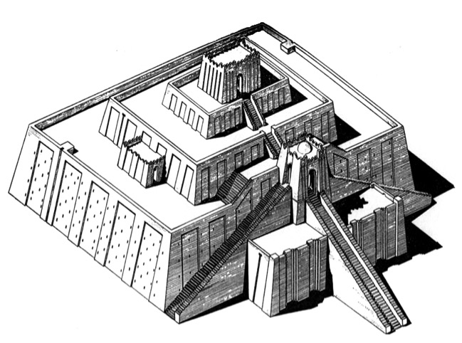
DRESSING
THE
STAGE
aNrae&m 10 ck
aNr
6
4
*g
O
DS
O&
yg;
RS
cgv'JNynf? O&NrdKU
Handbook pg. 15-16
29

Slide 30
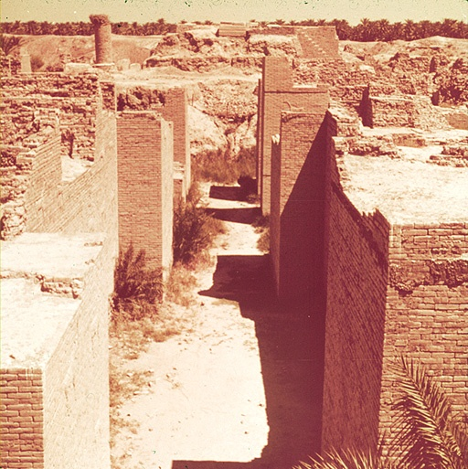
DRESSING
THE
STAGE
aNrae7m 10 ck
aNr
6
4
*g
O
bm
DS
O&
bmbDvHk
yg;
RS
Handbook pg. 15-16
30

Slide 31

DRESSING
THE
STAGE
aNrae&m 10 ck
aNr
6
4
[m
*g
O
bm
ao
O&
[m&ef
([m&ef? wl&uD)
yg;
RS
Handbook pg. 15-16
31

Slide 32
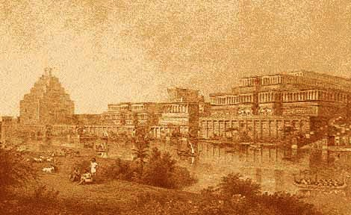
DRESSING
THE
STAGE
aNrae&m 10 ck
aNr
6
4
ed(tm)
[m
*g
O
bm
ao
O&
edea0(tm&I&d)armfql;vf?tD&wf
yg;
RS
Handbook pg. 15-16
32

Slide 33
DRESSING
THE
STAGE
aNrae&m 10 ck
aNr
6
4
ed(tm)
[m
*g
O
bm
ao
O&
yg;
yif
Handbook pg. 15-16
33

Slide 34
DRESSING
THE
STAGE
aNrae&m 10 ck
aNr
6
4
ed(tm)
[m
cg
*g
rsufarSmuf cgeef
O
bm
ao
O&
yg;
yif
Handbook pg. 15-16
34
1

Slide 35
DRESSING
THE
STAGE
aNrae&m 10 ck
aNr
6
4
ed(tm)
[m
*g
cg
O
a,
bm
a,&k&SvifNrdKU
ao
O&
yg;
yif
Handbook pg. 15-16
35

Slide 36
DRESSING
THE
STAGE
aNrae&m 10 ck
aNr
6
4
ed(tm)
[m
*g
cg
O&
eDabm awmif
a,
eD
bm
ao
O&
yg;
yif
Handbook pg. 15-16
36

Slide 37

DRESSING
THE
STAGE
aNrae&m 10 ck
aNr
6
4
ed(tm)
[m
*g
cg
O
bm
a,
eD
uma'7St&yf
ao
um
O&
yg;
yif
Handbook pg. 15-16
37

Slide 38
DRESSING
THE
STAGE
aNrae&m 10 ck
aNr
6
4
ed(tm)
[m
tD*spf
SG
cg
O
bm
a,
MN
ao
tD
um
O&
yg;
yif
Handbook pg. 15-16
38

Slide 39
DRESSING
THE
STAGE
aNrae&m 10 ck
aNr
6
4
ed(tm)
[m
*g
cg
O
odeawmif
bm
a,
eD
ao
tD
um
O&
od
yg;
yif
Handbook pg. 15-16
39

Slide 40
DRESSING
THE
STAGE
aNrae&m 10 ck
aNr
6
4
ed(tm)
[m
10 aNrae&m
*g
cg
O
bm
a,
od
ao
tD
um
O&
od
yg;
yif
Handbook pg. 15-16
40
2

Slide 41
w&m; 20;1
DRESSING
THE
STAGE
aNrae&m 10 ck
aNr
6
4
ed(tm)
[m
” 'ef
rS
bma&Sb
txd”
*g
aNrae&m
cg
O
bm
a,
od
ao
tD
um
O&
od
yg;
yif
Handbook pg. 15-16
41
3

Slide 42
DRESSING
THE
STAGE
aNrxJyifv,f
edea0 (tm&I&d)
[m&ef
*gvdvJtdkif
Oz7yfNrpf
cgeefNynf
edabmawmif
bmbdvHk
a,&k&Svif
Yyifv,fao
tD*spf
NzpfysufykH
tqif.qif!
O&
uma'&S
odemawmif
yg;&Sm;yif
v,fauGU
Yyifv,feD
Handbook pg. 15-16
42

Slide 43
DRESSING
THE
STAGE
vQyfwjyufNyefvSef
oHk;oyf&ef
tcsdef...
Handbook pg. 15-16
43

Slide 44
DRESSING
THE
STAGE
Handbook pg. 15-16
44

Slide 45
DRESSING
THE
STAGE
Handbook pg. 15-16
45

Slide 46
DRESSING
THE
STAGE
Handbook pg. 15-16
46

Slide 47
DRESSING
THE
STAGE
Handbook pg. 15-16
47

Slide 48
DRESSING
THE
STAGE
aNr
Handbook pg. 15-16
48

Slide 49
DRESSING
THE
STAGE
aNr
O
Handbook pg. 15-16
49

Slide 50
DRESSING
THE
STAGE
aNr
O
yg;
Handbook pg. 15-16
50

Slide 51
DRESSING
THE
STAGE
aNr
(aNrxJyifv,f)
O
(Oz&yfNrpf)
yg;
(yg;&Sm;yifv,fauGU)
Handbook pg. 15-16
51

Slide 52
DRESSING
THE
STAGE
aNr
O
yg;
Handbook pg. 15-16
52

Slide 53
DRESSING
THE
STAGE
aNr
O
yg;
yif
Handbook pg. 15-16
53

Slide 54
DRESSING
THE
STAGE
aNr
O
yg;
yif
Handbook pg. 15-16
54

Slide 55
DRESSING
THE
STAGE
aNr
O
yg;
yif
Handbook pg. 15-16
55

Slide 56
DRESSING
THE
STAGE
aNr
O
yg;
yif
Handbook pg. 15-16
56

Slide 57
DRESSING
THE
STAGE
aNr
*g
O
yg;
yif
Handbook pg. 15-16
57

Slide 58
DRESSING
THE
STAGE
aNr
*g
O
ao
yg;
yif
Handbook pg. 15-16
58

Slide 59
DRESSING
THE
STAGE
aNr
*g
O
a,mf'efNrpf
ao
yg;
yif
Handbook pg. 15-16
59
1

Slide 60
DRESSING
THE
STAGE
aNrae&m 10 ck
aNr
*g
O
ao
yg;
yif
Handbook pg. 15-16
60

Slide 61
DRESSING
THE
STAGE
aNrae&m 10 ck
aNr
4
*g
O
ao
yg;
yif
Handbook pg. 15-16
61

Slide 62
DRESSING
THE
STAGE
aNrae&m 10 ck
aNr
6
4
Y*g
O
ao
yg;
yif
Handbook pg. 15-16
62

Slide 63
DRESSING
THE
STAGE
aNrae&m 10 ck
aNr
6
4
*g
O
ao
O7
yg;
yif
Handbook pg. 15-16
63

Slide 64
DRESSING
THE
STAGE
aNraw&m 10 ck
aNr
6
4
*g
O
bm
ao
O7
yg;
yif
Handbook pg. 15-16
64

Slide 65
DRESSING
THE
STAGE
aNrae7m 10 ck
aNr
6
4
[m
*g
O
bm
ao
O7
yg;
yif
Handbook pg. 15-16
65

Slide 66
DRESSING
THE
STAGE
aNrae7m 10 ck
aNr
6
4
ed(tm)
[m
*g
O
bm
ao
O7
yg;
yif
Handbook pg. 15-16
66

Slide 67
DRESSING
THE
STAGE
aNrae7m 10 ck
aNr
6
4
ed(tm)
[m
*g
O
bm
ao
O7
yg;
yif
Handbook pg. 15-16
67

Slide 68
DRESSING
THE
STAGE
aNrae7m 10 ck
aNr
6
4
ed(tm)
[m
cg
*g
O
bm
ao
O7
yg;
yif
Handbook pg. 15-16
68

Slide 69
DRESSING
THE
STAGE
aNrae7m 10 ck
aNr
6
4
ed(tm)
[m
*g
cg
O
a,
bm
ao
O7
yg;
yif
Handbook pg. 15-16
69

Slide 70
DRESSING
THE
STAGE
aNrae7m 10 ck
aNr
6
4
ed(tm)
[m
*g
cg
O
eD
bm
a,
ao
O7
yg;
yif
Handbook pg. 15-16
70

Slide 71
DRESSING
THE
STAGE
aNrae7m 10 ck
aNr
6
4
ed(tm)
[m
*g
cg
O
bm
a,
eD
ao
um
O7
yg;
yif
Handbook pg. 15-16
71

Slide 72
DRESSING
THE
STAGE
aNrae7m 10 ck
aNr
6
4
ed(tm)
[m
*g
cg
O
bm
a,
eD
ao
tD
um
O7
yg;
yif
Handbook pg. 15-16
72

Slide 73
DRESSING
THE
STAGE
aNrae7m 10 ck
aNr
6
4
ed(tm)
[m
*g
cg
O
bm
a,
eD
ao
tD
um
O7
od
yg;
yif
Handbook pg. 15-16
73

Slide 74
DRESSING
THE
STAGE
aNrae7m 10 ck
aNr
6
4
ed(tm)
[m
*g
cg
O
bm
a,
eD
ao
tD
um
O7
od
yg;
yif
Handbook pg. 15-16
74
1

Slide 75
DRESSING
THE
STAGE
aNrae7m 10 ck
aNr
6
4
ed(tm)
[m
aNrwnfae7m
*g
cg
O7
bm
a,
eD
ao
” 'ef
rS
bma&Sb
txd”
TtD
um
O7
od
yg;
w7m;20;1
yif
Handbook pg. 15-16
75

Slide 76
DRESSING
THE
STAGE
aNrxJyifv,f
edea0 (tm7I7d)
[m7ef
*gvdvJtdkif
Oz7yfNrpf
cgeefNynf
eDabmawmif
bmbdvHk
NzpfysufonfU
yHk
tqif.qif.
a,7k7Svif
Yyifv,fao
tD*spf
O7
uma'7S
odemawmif
yg;7Sm;yif v,fauGU
Yyifv,feD
Handbook pg. 15-16
42

Slide 77
DRESSING
THE
STAGE
Þtjzpftysuftm;vHk;\
taMumif;7if;...
Handbook pg. 15-16
77

Slide 78
aNrMoZmaumif;rGefaom aNrmufbuft7yfrSonf aNcmufuyfaom awmift7yfqDodkY…
Handbook pg. 15-16
78

Slide 79
DRESSING
THE
STAGE
aNr
ed(tm)
[m
*g
cg
O
bm
a,
eD
ao
usrf;pmygtNzpftysufrsm; oif.todOmPfrsufpd wGif tpDpOftvdkufxm;edkifonf!
tD
um
O7
od
yg;
yif
Handbook pg. 15-16
79
1

Slide 80
DRESSING
THE
STAGE
aNr
zefqif;Ncif;
ed(tm)
tmNA[H
[m
a,moyf
SG
C
arma7S
a,m7I
ER
bm
J
rif;rJhumv
MN
bk7ifacmwf
ao
odrf;oGm;7mumv
tD
qdwfNidrf&mumv
um
a,7I
U
od
yg;
yif
Handbook pg. 15-16
80

Slide 81
DRESSING
THE
STAGE
,©Koif.tvSnfh… oif.OD;aPSmufxJwGif&Sdaom ta7SUtv,fydkif;aNryHkudk
qGJyg!
COMPLETED MAPS AT STUDY HELP #30
Handbook pg. 15-16
81

Slide 82
pOfqufpm7if; vQifNrefpGmav.vmNcif;
“Where is that place, anyway?”
“aemufydkif;wGif wnfae7mtm;vHk;udk oifod7Sdvmygvdrf.rnf!”
Handbook pg. 15-16
1
82

Slide 83

,©Kþ usrf;pmtaNccHususav.vmNcif;tpDt pOfwGifoifawG;awmaeaomt7mwpfck7Sdonf
•¤if;wdkYrSm “usrf;pmrSwfpk”
•OD;aPSmufxJwGif twdkaumufNzif. rSwfom;xm;aom usrf;pmrSwfpk…C 7 S J
•OD;aPSmufxJ7Sd usrf;pmygt"dduusonf. tNzpftysufrsm;
•usrf;pm “yHkNyif”? “ tpOfvdkuf rsdK;7kd;pOfqufpm7if;”
1
83

Slide 84
or®musrf;pm-
tkwfNrpf
Texas jrdk.rS or®musrf;pm-tkwfjrpf(edkifiHwumtrSkawmfaqmifvkyfief;)\ wifjycsuf
www.biblebasically.org

Slide 85


တရားေဟာျခင္းအ တတ္ပညာ • BibleStudyDownloads.org
အခမဲ့အဘို့ဤတင်ပြချက်
Notes:
Preaching (pr)
Homiletics

Slide 86
Black

